Slide 1
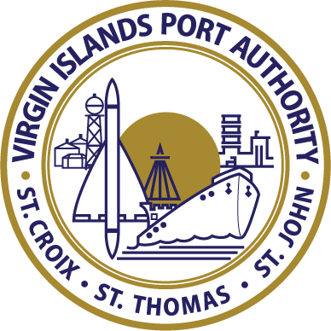
VIRGIN ISLANDS PORT AUTHORITY
An Overview of Our Plans & Projects Scheduled for Fiscal Year 2016 and Beyond
Presentation to the USVI Hotel & Tourism Association
Friday, November 20, 2015

Slide 2
The Virgin Island Port Authority An Overview
Most port authorities in the world manage either airports or seaports.
The Virgin Islands Port Authority is one of the few port authorities that manages both air and seaports.
2 Airports: We own and manage the Cyril E. King Airport on St. Thomas and the Henry E. Rohlsen Airport on St. Croix
14 Seaports: VIPA also owns and manages the majority of public seaports on St. Thomas, St. John and St. Croix, which includes cruise, cargo and ferry ports.

Slide 3
The Virgin Island Port Authority An Overview
The VI Port Authority was created as a semi-autonomous, self-sustaining agency. We do not receive funds from the local government.
Funding sources: 1. Revenue from fees charged to users of our facilities per our aviation and marine tariff. 2. The financing of bonds approved by the VI Legislature. 3. Federal grants, primarily from the Federal Aviation Administration (FAA) and limited to FAA-approved projects. 4. The Passenger Facility Charge Program (PFC), which is also limited to FAA approved projects.

Slide 4
The Virgin Island Port Authority Fiscal Year 2016 Budget
FY 2016 Budget Outlay
Operating Expenses: $43.5 million
Debt Service: $5.7 million
Capital Projects/Expenditures: $33.2 million Total: $82.4 Million

Slide 5
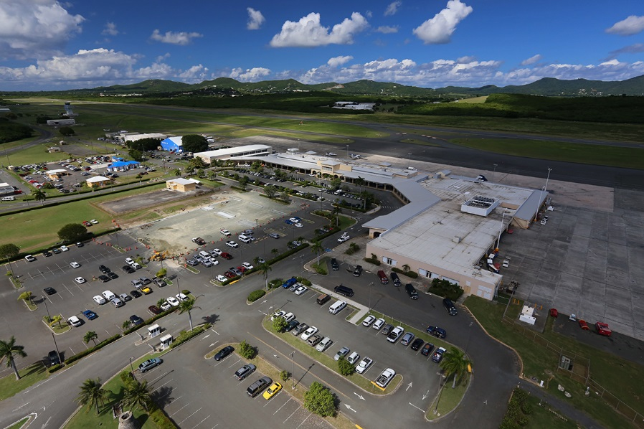
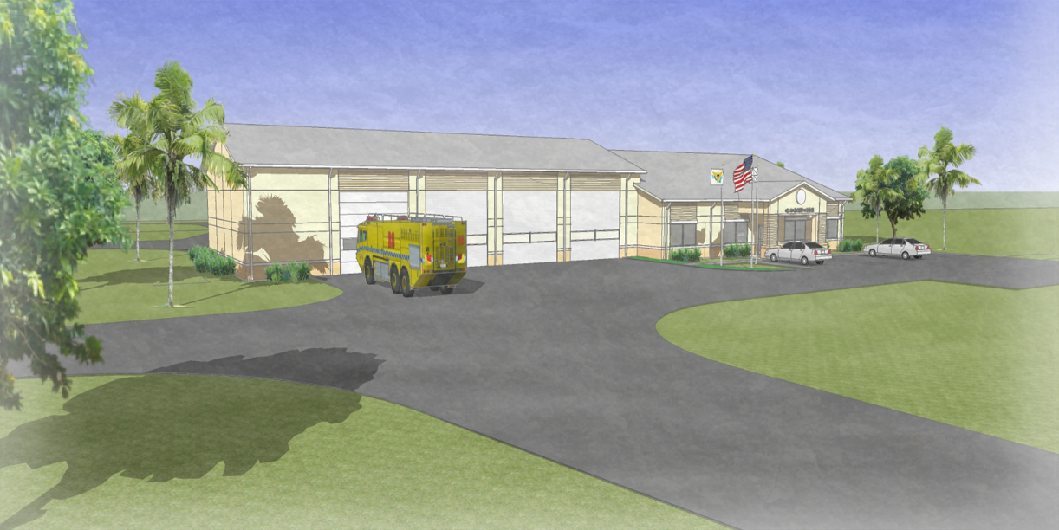
The Virgin Island Port Authority Developing our Airports
Henry E. Rohlsen Airport, St. Croix
New Aircraft Rescue and Fire Fighting Facility ($6.8 mil grant received from FAA in 2015)
Terminal apron rehabilitation project completion
Generator containment slab

Slide 6
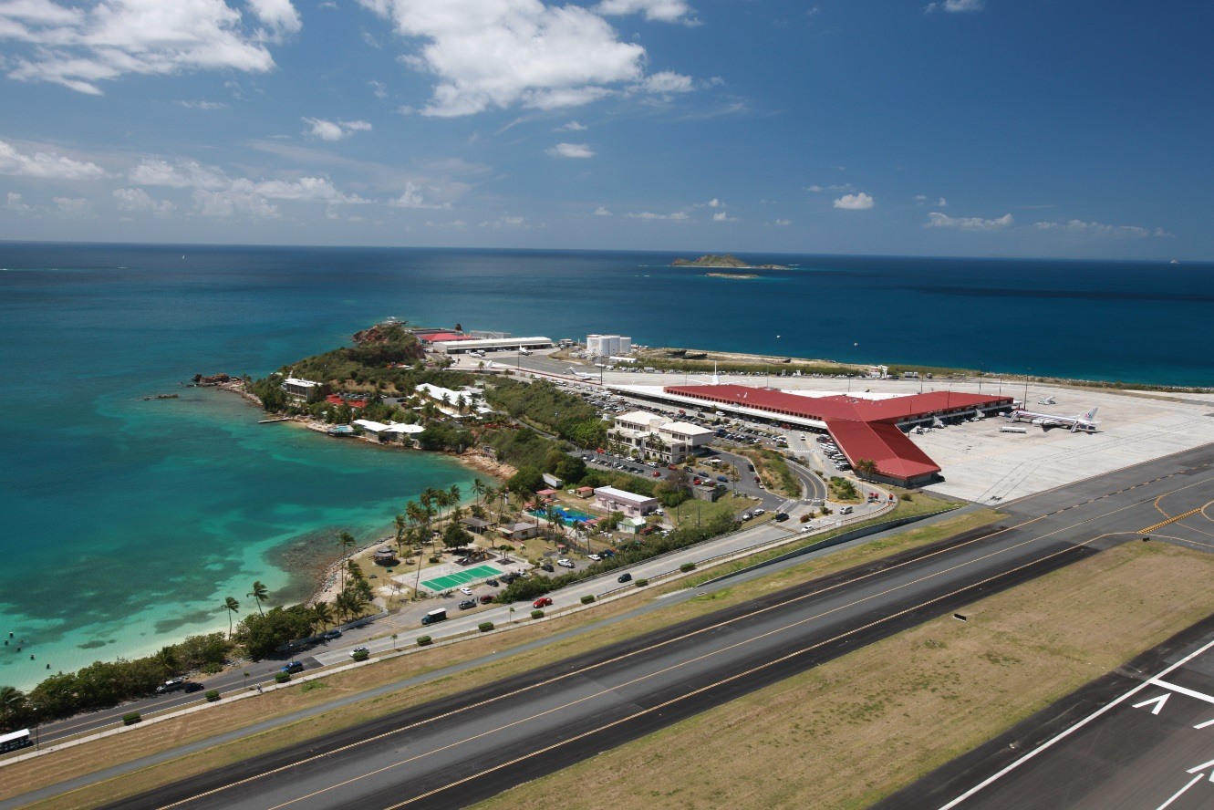
The Virgin Island Port Authority Developing our Airports
Cyril E. King Airport, St. Thomas
Installation of a public address system
Upgrade the terminal’s fire alarm & sprinkler system
Renovate terminal restrooms
Taxiway B Design Master Plan/ Edge Lighting
Construct a parking garage adjacent to the terminal
Upgrade generator electrical room
Pad mount switch – waste water treatment plant

Slide 7
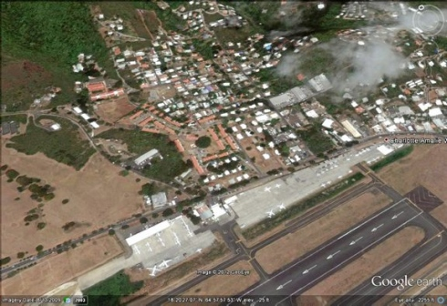
The Virgin Island Port Authority Developing our Airports
Cyril E. King Airport, St. Thomas
Demolition of derelict units at Bournefield, a residential property owned by VIPA located adjacent to the King Airport
Relocate VIPA’s maintenance building located on airport property to vacant land in Bournefield so that we can expand the general aviation area for private jet parking.

Slide 8
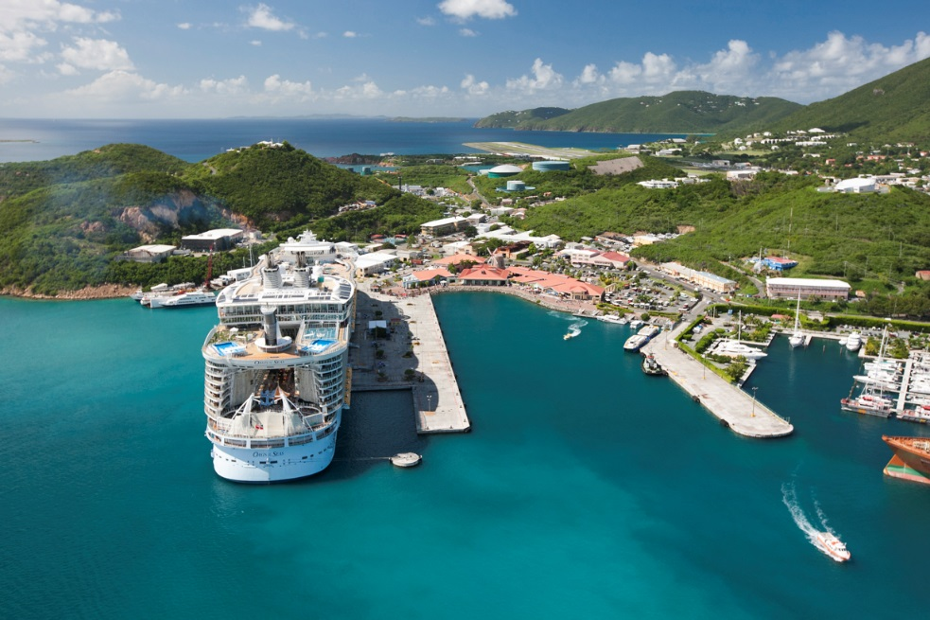
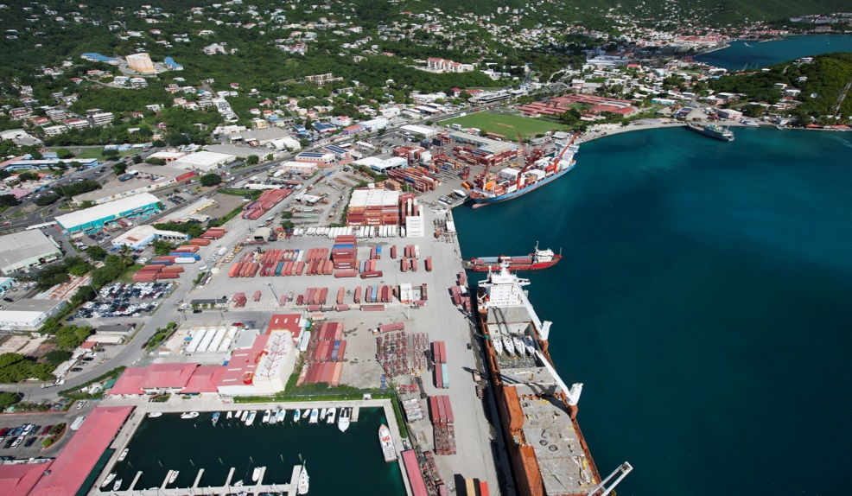
The Virgin Island Port Authority Developing our Seaports
Crown Bay, St. Thomas
Dock expansion – filling in notch at the end of the cruise ship pier
Crown Bay Center parking lot resurfacing
Maintenance dredging
Cargo area bulkhead and fendering repairs

Slide 9
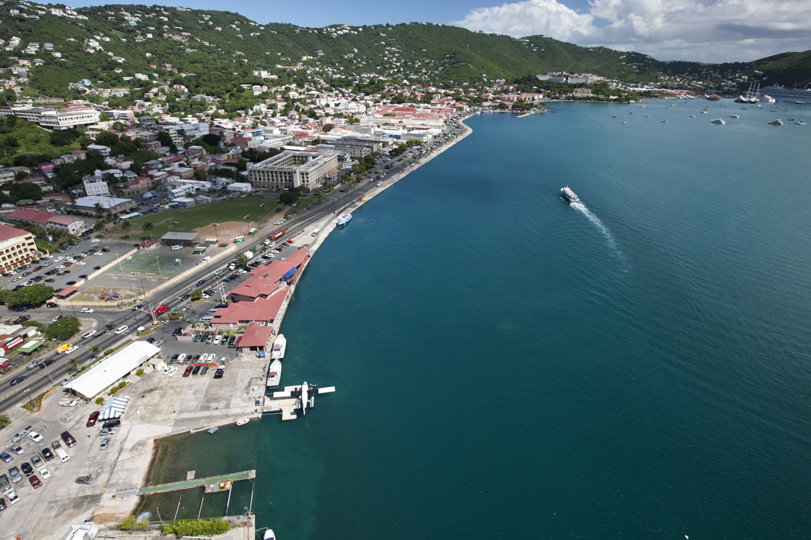
The Virgin Island Port Authority Developing our Seaports
E. Blyden Terminal/Waterfront
Installation of an elevator to bring the facility into compliance with the Americans with Disabilities Act
Upgrades to the fendering system

Slide 10
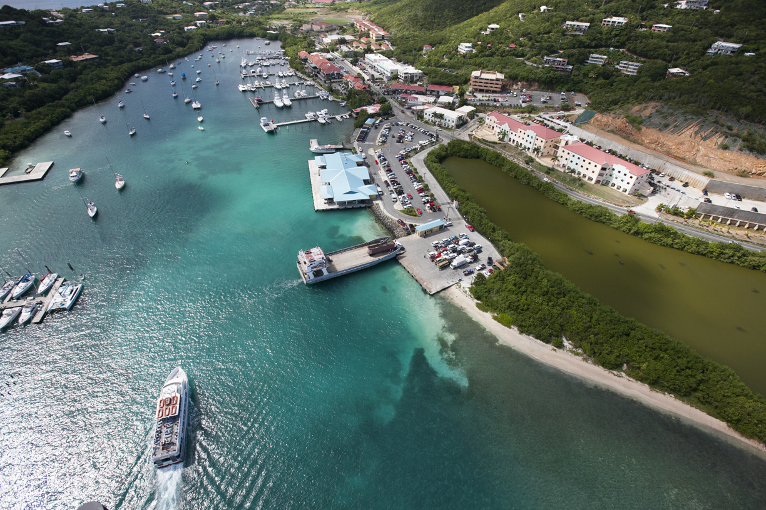
The Virgin Island Port Authority Developing our Seaports
Urman V. Fredericks Marine Terminal, Red Hook
Design to construct a double level parking lot
Design to construct a US Customs & Border Patrol building to reduce travel time between the USVI and foreign ports.

Slide 11
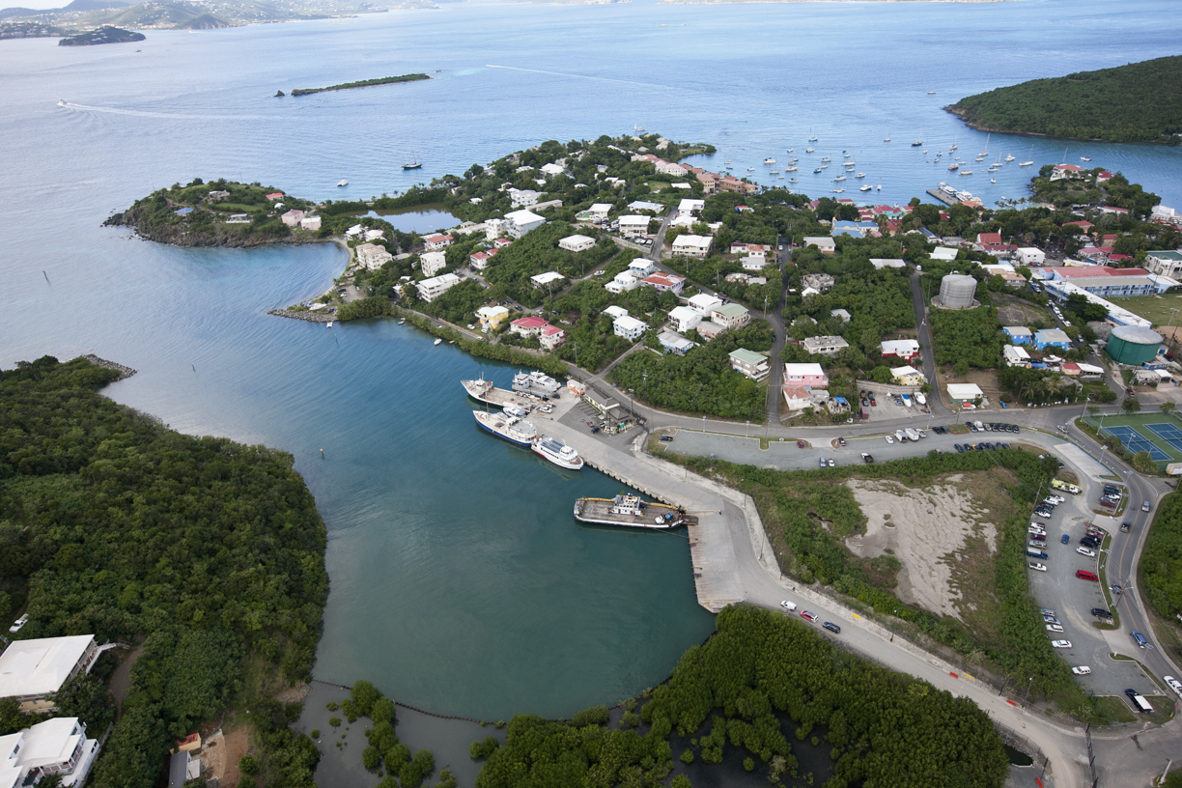
The Virgin Island Port Authority Developing our Seaports
St. John Seaports
Upgrade the parking lot and install a paid parking system at the Theovald Moorehead Marine Facility, Enighed Pond
Construction of a cargo apron at the Moorehead Marine Facility
Install paid parking system at the Victor Sewer Marine Facility in Cruz Bay (The Creek)

Slide 12
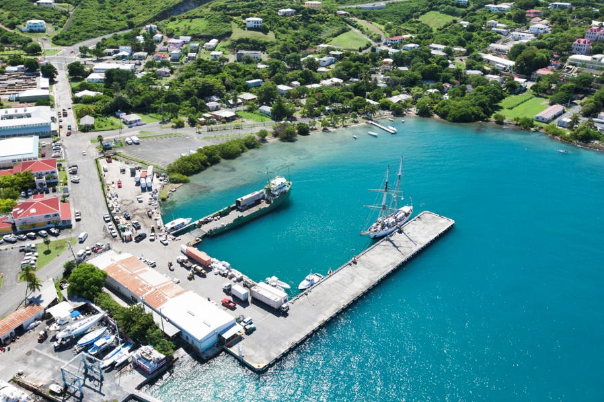
The Virgin Island Port Authority Developing our Seaports
Gallows Bay, Christiansted
Pavement resurfacing and shoreline revetment
Schooner Bay Channel dredging (design only)
Major renovation of the dual-purpose arrival facility.

Slide 13
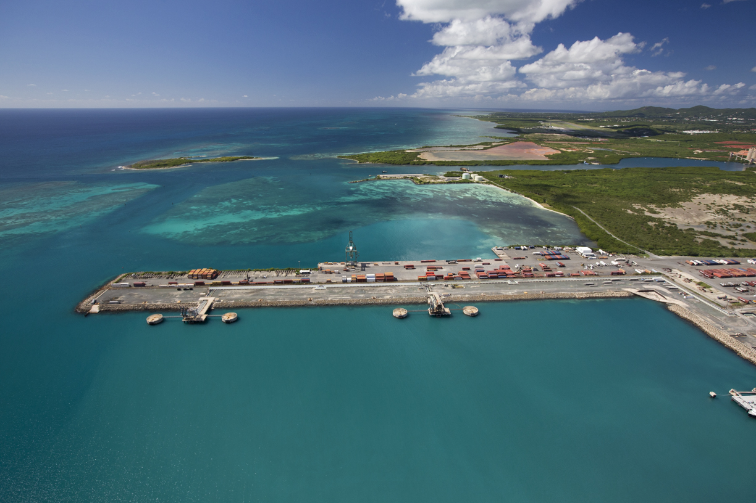
The Virgin Island Port Authority Developing our Seaports
Wilfred Allick Port & Transshipment Center, St. Croix
Installation of 100-ton bollard on the south pier
Pavement resurfacing
Installation of a new perimeter security fence
Upgrade lighting system
Structural repairs to the pier
Fire protection system (design only)

Slide 14
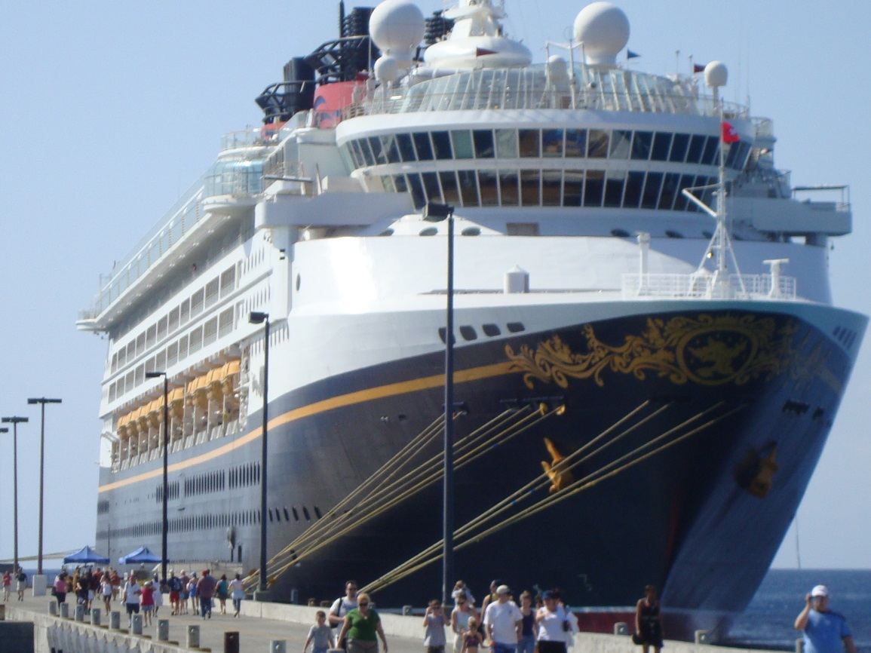
The Virgin Island Port Authority Developing our Seaports
Ann E. Abramson Marine Facility, Frederiksted, St. Croix
Catwalk and bollard replacement (design only)
Upgrade pier lighting system
South Tender Landing replacement

Slide 15
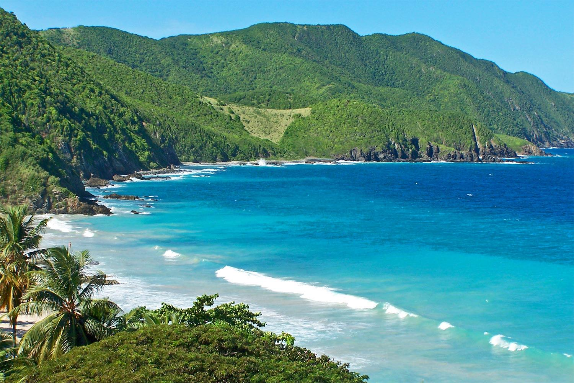
Connecting our Islands to the World
Gateways to the USVI Economy
www.viport.com

