Slide 1
Caribbean Hotel Industry Performance
Duane Vinson
Vice President
Assistant Director of the STR SHARE Center
dvinson@str.com

Slide 2
Agenda
Global Perspective
Overview of the Region
Caribbean Performance

Slide 3
www.hotelnewsnow.com
Data Dashboard>View All Data Presentations

Slide 4

STR Coverage – Our Census Database
Branded vs. Unbranded Room Count Share
40%
66%
60%
34%
55%
45%
52%
48%
41%
37%
59%
63%
Branded
Unbranded

Slide 5

STR Coverage – Our Sample
Hotels & Hotel Rooms
+34K
+9.4K
+4,100K
+1,200K
+780
~250
+191K
+8K
Caribbean
+62K
+1,500K
80% Luxury, Upper Upscale, Upscale Class
20% Upper Midscale, Midscale, Economy Class
+770
+1.1K
+139K
+170K
Hotels
Rooms

Slide 6
RevPAR % Change, August 2016 YTD
Europe
North America
-2.2% (+2.1%)
+2.7% (+3.0%)
Middle East
Asia
-8.3% (-9.6%)
-2.0% (+0.4%)
Central America
Northern Africa
+2.3% (+3.0%)
-8.5% (-1.0%)
South America
-7.4% (+10%)
Southern Africa
-5.7% (+6.9%)
Australia & Oceania
+0.9% (+3.8%)
USD, Europe in EUR, (Constant Currency)

Slide 7
Global Picture
Pipeline % increase # of rooms, July 2016 Report
3%
10%
14%
52%
11%
14%

Slide 8
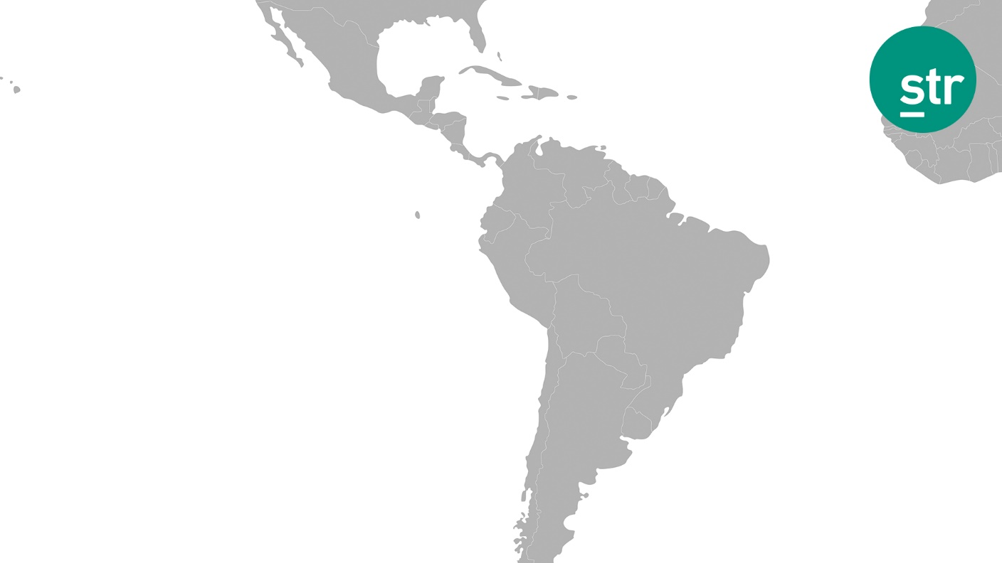
US
2014 2015 8/2016
3.4% 1.6% -0.2%
Mexico
2014 2015 8/2016
5.1% 0.8% -0.8%
Caribbean
2014 2015 8/2016
2.3% 1.3% -3.6%
Central America
2014 2015 8/2016
-1.9% 2.4% 3.7%
South America
2014 2015 8/2016
-2.2% -4.9% -5.0%
Occupancy % Change
Caribbean, US, Mexico, Central & South America
Full Year 2014, 2015, YTD August 2016

Slide 9
US
2014 2015 8/2016
4.6% 4.5% 3.1%
Mexico(₱)
2014 2015 8/2016
2.6% 17.7% 15.2%
Caribbean
2014 2015 8/2016
7.3% 4.2% -3.4%
Central America
2014 2015 8/2016
0.7% -0.3% -1.3%
South America
2014 2015 8/2016
-4.5% -24.1% -2.5%
ADR % Change
Caribbean, US, Mexico, Central & South America
Full Year 2014, 2015, YTD August 2016

Slide 10
Caribbean YTD August 2016
% Change
Room Supply 1.2%
Room Demand -2.4%
Occupancy 69.7% -3.6%
A.D.R. $228 -3.4%
RevPAR $159 -6.9%

Slide 11
Sustained development and softening demand
Oct ’12
5.1%
Apr ’15
4.6%
Mar ’09
1.8%
1.3%
-1.1%
First reported case of
Zika in Brazil May 2015
Jan ’11
-3.1%
Jun ’07
-4.8%
First LA case in Caribbean
Martinique December 2015
Aug ’09
-9.6%
Caribbean Room Supply/Demand Percent Change
Twelve Month Moving Average – 2009 to August 2016

Slide 12
Lower demand causing weaker Occ and less pricing power among hotels in the region…
First reported case of
Zika in Brazil May 2015
First LA case in Caribbean
Martinique December 2015
Caribbean Occupancy/ADR Percent Change
Twelve Month Moving Average – 2006 to August 2016

Slide 13
…which is leading to a steep decline in RevPAR
Caribbean RevPAR Percent Change
Twelve Month Moving Average – 2006 to August 2016

Slide 14
Resort Destination- Hawaii lead in occupancy
Actual Occupancy
August 2015 YTD vs. YTD 2016

Slide 15
Hawaii with highest Average daily Rate (ADR)
Actual ADR (USD)
August 2015 YTD vs. YTD 2016

Slide 16
RevPar % Change Mixed
RevPAR % Change (USD)
August 2015 YTD vs. YTD 2016

Slide 17

Select CHTA Countries
Occ, ADR & RevPAR, YTD Aug 2016
USD

Slide 18
Select CHTA Countries
Occ, ADR & RevPAR % Change, August 2016 YTD
Local Currency

Slide 19
STR Pipeline Phases
  In Construction – Vertical construction on the physical building has begun. (This does not include construction on any sub-grade structures.)
  Final Planning – construction will begin within the next 12 months.
  Planning – construction will begin in more than 13 months.
  Unconfirmed (formerly Pre-Planning) - Potential projects that remain unconfirmed at this time.
Under Contract

Slide 20
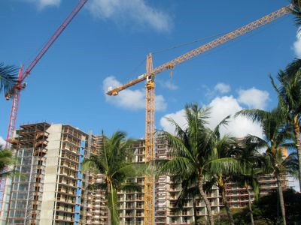
CHTA Area Active Development Pipeline
Phase | Projects | Rooms
In Construction | 29 | 6,348
Final Planning | 16 | 4,701
Planning | 14 | 2,268
Active Pipeline | 59 | 13,317
STR Construction Pipeline; August 2016
(includes the Caribbean, Belize, Cancun, Guyana, and Suriname)

Slide 21

United States
KPI Outlook (% Change vs. Prior Year)
Outlook
 | 2016 Forecast | 2017 Forecast
Supply | 1.6% | 2.0%
Demand | 1.6% | 1.6%
Occupancy | 0.0% | -0.3%
ADR | 3.2% | 3.1%
RevPAR | 3.2% | 2.8%

Slide 22
Caribbean
KPI Outlook (% Change vs. Prior Year)
Outlook
 | 2016 Forecast | 2017 Forecast
Occupancy | -3.7% | -2.0%
ADR | -3.1% | -2.5%
RevPAR | -6.7% | -4.5%

Slide 23
Issues Affecting Industry Performance
Several countries experiencing hotel occupancy declines because of the growth in shared accommodations and the Zika Virus
New supply growth in check thus far but picking up
Occupancy and ADR will continue to feel downward pressure in 2017

