Slide 1
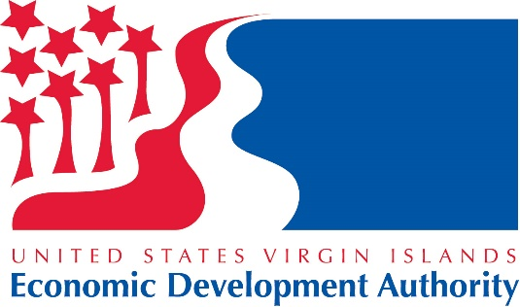
UNITED STATES VIRGIN ISLANDS
America’s Business Paradise

Slide 2
Economic Development Authority Services
One-stop shop supports companies establishing operations in the Territory
Provides information needed to make the right decision about expanding your
business to the USVI
Offers access and support, help with:
Coordinates your project and site visits
Facilitates the application process for tax benefits
Provides ongoing company support
Real estate
Logistics, supply chain
Government regulations
Human Resources
Legal, accounting requirements
Financial support and incentives

Slide 3
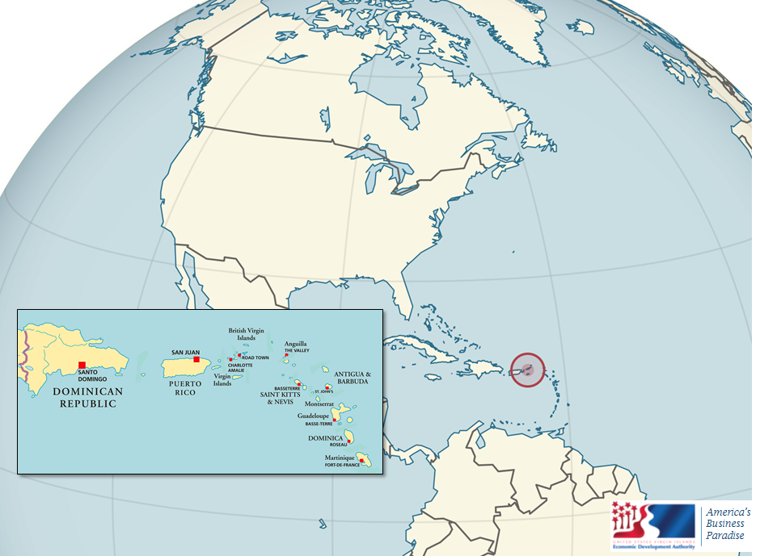
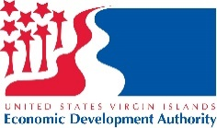
USVI: All the Benefits of the U.S.
United States Territory:
U.S. Law
U.S. Currency
U.S. Postal Service
Population: 110,000
Work force: 52,000
Total area: 219 square miles
Access to key markets:
87 million Caribbean basin consumers
419 million South American consumers
478 million North American consumers
NEW YORK
1,500 MI; 2,415 KM
EUROPE
4,000 MI; 6,438 KM
MIAMI
1,200 MI; 1,932 KM
PANAMA
1,200 MI; 1,932 KM
BRAZIL
2,500 MI; 4,024 KM
Notes:
The Territory’s proximity to key markets makes the U.S. Virgin Islands a strategic location for business

Slide 4
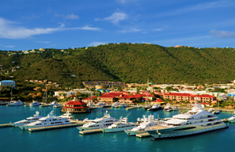
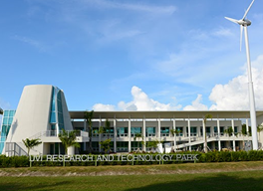
Business Location Opportunities
Modern office facilities available in Charlotte Amalie, Christiansted and Frederiksted
University of the Virgin Islands Research & Technology Park
Enterprise Zones
Commercial Zones
Opportunity Zones
America’s Business Paradise

Slide 5
Robust Business Incentives
90% federal corporate income tax exemption
90% federal personal income tax exemption
100% exemption on business property taxes
100% exemption on gross receipts tax
100% exemption on excise tax
Imported goods customs duty is cut to 1%
No local or territorial taxes
Subsidized rental space
…. Oh, and you get to work in a tropical paradise

Slide 6
Benefit Periods
30 Years
St. Croix District
20 Years
St. Thomas/St. John District
10 Years
One-Time Extension
10 Years
Investment greater than $10M
5 Years
Investment greater than $1M

Slide 7
US Virgin Islands – 2018 Tax Rates
C Corporation | US | USVI
 | Code | Mirror Code
Taxable Income | $28.2 million | $28.2 million
Corporate Tax Rate (maximum) | 21% | 2.3%
Corporate Tax Liability | $5.9 million | $649,000
Pass-Through Entity (US Citizen/VI Resident Owners) | US | USVI
 | Code | Mirror Code
Taxable Income | $7.6 million | $7.6 million
Individual Tax Rate (maximum) | 37% | 3.7%
Tax Liability | $2.8 million | $281,200
There are NO state, local or territorial income taxes in the US Virgin Islands
Notes:
The 21% to 2.3% is the effective tax rate after reduction of exemptions. There is a 10% surcharge for corporations filing taxes in the US Virgin Islands. Below is the example for the Corporate Income Tax:
Taxable Income $ 28,200,000
Tax on $2.8 Mil taxable income (21%) $ 5,900,000
USVI Corporate surcharge (10%) $ 590,000
Total tax $ 6,490,000
90% reduction $ 5,841,000
Net tax (Effective tax rate of 2.31%) $ 649,000
A 90% exemption applies to the individual income tax liability of USVI bona-fide resident stockholders on income derived from dividends of the corporation or, for S corporation or partnership distributions. The maximum tax rate is 37% so 90% reduction results in an effective tax rate of 3.7%

Slide 8
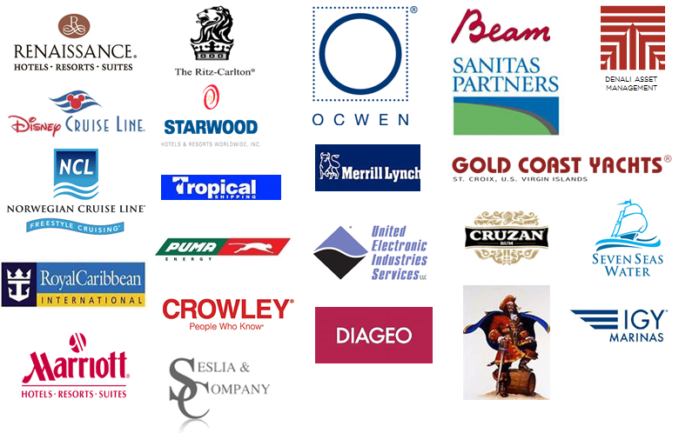
Join the Crowd

Slide 9
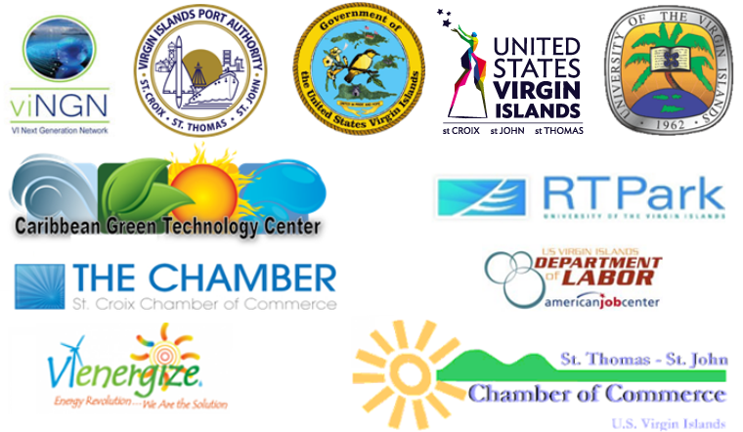
Our Team Supports Your Project

Slide 10
America’s Business Paradise
To learn more about please contact me at:
klatham@usvieda.org
340-714-1700 ext.1111
U.S. Virgin Islands Economic Development Authority
www.usvieda.org
info@usvieda.org
St Croix
340-773-6499
St Thomas
340-714-1700

